Slide 1

Chapter 6
Managing The
Business
Copyright © 2014 Pearson Canada Inc.
6-<number>

Slide 2
Learning Objectives
Describe the four basic functions that constitute the management process.
Identify types of managers by level and area.
Describe the five basic management skills.
Explain the importance of setting goals and formulating strategies.
Discuss contingency planning and crisis management.
Explain the idea of corporate culture and why it is important.
Copyright © 2014 Pearson Canada Inc.
6-<number>
Notes:
These learning objectives are based upon those at the beginning of the chapter. For a review of learning objectives, see the summary at the end of the chapter, as well as the list of key terms.

Slide 3
The Management Process
(LO 6-1)
Planning
Leading
Functions of Management
Organizing
Controlling
Copyright © 2014 Pearson Canada Inc.
6-<number>
Notes:
26
26
Learning Objective: 6-1
Notes
Management- A series of activities developed to allow businesses to achieve their goals
Planning
Leading
Organizing
Controlling

Slide 4
The Management Process
(LO 6-1)
Planning
  Determining what the business needs to do and the best way to achieve it
Resource allocation, firm’s priorities, step to meet strategic goals, e.g. increase earnings by 75% by 2020
Strategic plans – senior mgt
Tactical plans – upper + middle mgt
How to implement strategic plans, e.g. grow sales in Europe by building European bottling facilities
Short-term targets for daily, weekly or monthly performance, e.g. how to cook and serve Big Macs
Operational plans – middle + lower mgt
Copyright © 2014 Pearson Canada Inc.
6-<number>
Notes:
26
26
Learning Objective: 6-1
Activities:
Questions for Analysis #3
Application Exercises #1

Slide 5
The Management Process
(LO 6-1)
Organizing
  Determining how to use existing resources to implement the plan
  Arranging jobs in a structure to create an efficient task system
  E.g. organize into divisions or combine into 1 division?
Copyright © 2014 Pearson Canada Inc.
6-<number>
Notes:
28
28
Learning Objective: 6-1

Slide 6
The Management Process
(LO 6-1)
Leading
  Guiding and motivating subordinates to meet the firm’s objectives
  managers have various responsibilities with regard to their employees
Authority to give orders
Ability to guide employees
Power to motivate subordinates – Daniel Pink https://www.ted.com/talks/dan_pink_on_motivation
Copyright © 2014 Pearson Canada Inc.
6-<number>
Notes:
29
29
Learning Objective: 6-1

Slide 7
Richard Barrett - Leadership Crisis – The New Leadership Paradigm
Over the past fifty years, leadership scholars have conducted more than a thousand studies in the attempt to determine the definitive leadership styles, characteristics, or personality traits of great leaders. None of these studies has produced a clear profile of the ideal leader. Thank goodness.
You need to be who you are, not try to emulate somebody else. … Leaders are defined by their unique life stories and the way they frame their stories to discover their passions and the purpose of their leadership.
What concerns me are the many powerful business leaders who bowed to stock market pressure in return for personal gain. They lost sight of their True North and put their companies at risk by focusing on the trappings and spoils of leadership instead of building their organisations for the long term. … The result was a severing of trust with employees, customers, and shareholders. … In business trust is everything.
Every successful business leader has to make the shift from “I” to “We.
http://tnlp.valuescentre.com/pages/fundamentals/a-leadership-crisis.php

Slide 8
Richard Barrett – 7 Levels of Organizational Consciousness
https://www.valuescentre.com/mapping-values/barrett-model/organisational-consciousness
Applies to all types of organisations—corporations, government departments, municipal agencies, institutions, non‐governmental organisations (NGO), and educational establishments.

Slide 9
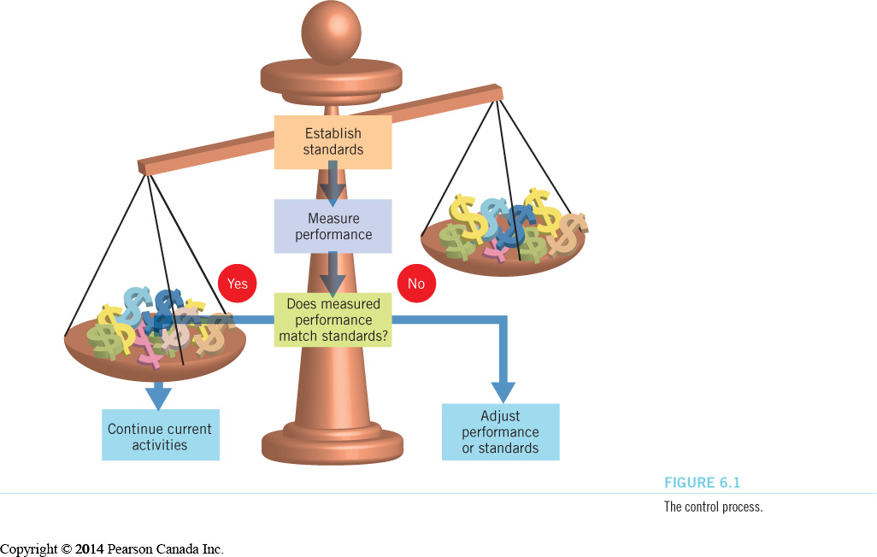
The Management Process
(LO 6-1)
Controlling: managers monitor the firm’s performance
  determine if goals have been met
  determine what actions were most effective in achieving goals
  understand what went wrong and how to fix it
  E.g. on-time arrivals, number of empty seats
Copyright © 2014 Pearson Canada Inc.
6-<number>
Notes:
30
30
Learning Objective: 6-1
Figure 6.1

Slide 10
Types of Managers
(LO 6-2)
Levels of Management
Top management
  responsible for overall performance of the firm
Middle management
  responsible for implementing decisions of top managers
First-line management
  responsible for supervising employees
Copyright © 2014 Pearson Canada Inc.
6-<number>
Notes:
32
32
Learning Objective: 6-2
Table 6.1
Activities
Question for Analysis #4

Slide 11
Types of Managers
(LO 6-2)
Areas of Management
Marketing Managers
Financial Managers
Operations Managers
Human Resource Managers
Information Managers
Copyright © 2014 Pearson Canada Inc.
6-<number>
Notes:
Learning Objective 6-2

Slide 12
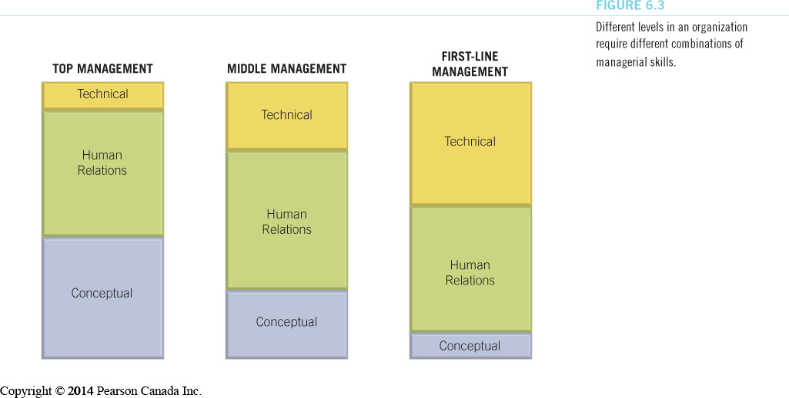
Basic Management Skills
(LO 6-3)
Technical skills
Human Relations skills
Conceptual skills
Time Management skills
Decision-Making skills
Copyright © 2014 Pearson Canada Inc.
6-<number>
Notes:
Learning Objective 6-3
Figure 6.3
Notes
Different levels in an organization require different combinations of managerial skills.
Activities
Questions for Analysis #1, 4

Slide 13
Basic Management Skills
(LO 6-3)
Time-Management Skills
  productive use of time
leading causes of wasted time
  paperwork
  telephone
  meetings
  email
Copyright © 2014 Pearson Canada Inc.
6-<number>
Notes:
Learning Objective: 6-3

Slide 14
Basic Management Skills
(LO 6-3)
Decision-Making Skills
Recognize and define the decision situation
Identify alternatives
Evaluate the alternatives
Select the best alternative
Implement the chosen alternative
Follow up and evaluate the results
Copyright © 2014 Pearson Canada Inc.
6-<number>
Notes:
Learning Objective: 6-3
Figure 6.4

Slide 15
Basic Management Skills
(LO 6-3)
Behavioural Aspects of Decision Making
Organizational Politics
Intuition
Escalation of Commitment
Risk Propensity
Copyright © 2014 Pearson Canada Inc.
6-<number>
Notes:
Learning Objective: 6-3

Slide 16
Setting Goals and Formulating Strategy
(LO 6-4)
Strategic Management
  the process of aligning the organization with its external environment
Strategic Goals
  the performance objectives that a firm plans to achieve
Copyright © 2014 Pearson Canada Inc.
6-<number>
Notes:
4
4
Learning Objective: 6-4
Notes
The text gives an ideal discussion of goals. It is important that students are able to describe what a goal (or objective) is and how it helps to operationalize the visions of management in deciding on the future of the organization.
Students may make lists of their own personal goals, particularly those that have led to them taking the course. A class discussion may be held to allow students to compare personal goals and discuss how their goals define and direct the decisions they have made. This must be related to the business planning process.

Slide 17
Setting Goals and Formulating Strategy
(LO 6-4)
Purpose of Setting Goals
Provides direction, guidance, and motivation
Assists in allocating resources
Helps to define corporate culture
Helps managers assess performance
Copyright © 2014 Pearson Canada Inc.
6-<number>
Notes:
Learning Objective: 6-4

Slide 18
Setting Goals and Formulating Strategy
(LO 6-4)
Kinds of Goals
Long-term
  five or more years
Intermediate
  one to five years
Short-term
  less than one year
Copyright © 2014 Pearson Canada Inc.
6-<number>
Notes:
Learning Objective: 6-4

Slide 19





Setting Goals and Formulating Strategy
(LO 6-4)
SMART Goals
Specific
Measurable
Achievable
Relevant
Time-Framed
Copyright © 2014 Pearson Canada Inc.
6-<number>
Notes:
Learning Objective: 6-4

Slide 20
Strategic Management
Why are you in business? Where are you going?
Vision
Strategy
Performance targets
Directions, guidance
Resources
Corporate culture
Performance assessment
How to outperform competitors + profit; how to gain competitive advantage
Customers – how?
Rivals – how?
Market standing – how?
Growth – how?
Performance targets – how?
Mission
Goals/Objectives
How will you achieve your purpose?
Products/services; needs it satisfies; customers; how are you different from rivals
Copyright © 2014 Pearson Canada Inc.
6-<number>
Notes:
4
4
Learning Objective: 6-4
Notes
The text gives an ideal discussion of goals. It is important that students are able to describe what a goal (or objective) is and how it helps to operationalize the visions of management in deciding on the future of the organization.
Students may make lists of their own personal goals, particularly those that have led to them taking the course. A class discussion may be held to allow students to compare personal goals and discuss how their goals define and direct the decisions they have made. This must be related to the business planning process.

Slide 21
Strategic Management: Setting Goals and Formulating Strategy
(LO 6-4)
Mission Statement
  Describes how the organization will achieve its purpose (reason for being)
  Clarifies who the organization serves, what it offers, and how it will be provided
  Includes core values and ethical commitment
Copyright © 2014 Pearson Canada Inc.
6-<number>
Notes:
6
6
Learning Objective: 6-4
Notes
While companies may have the same purpose, their mission may be different. Example:
-the purpose of a consulting business is primarily to seek profit
-the mission statement may be: “to provide affordable solutions to small and medium businesses...”

Slide 22
Vision & Mission
https://topnonprofits.com/examples/vision-statements/ Vision statement examples
http://www.alessiobresciani.com/foresight-strategy/51-mission-statement-examples-from-the-worlds-best-companies/ Mission statement examples
https://www.branham300.com/index.php?year=2017&listing=5
Copyright © 2014 Pearson Canada Inc.
6-<number>
Notes:
Learning Objective: 6-4

Slide 23
In-Class Activity
Pick a company and find + analyze their:
Vision statement
Mission statement
Copyright © 2014 Pearson Canada Inc.
6-<number>
Notes:
Learning Objective: 6-4

Slide 24
Strategic Management: Setting Goals and Formulating Strategy
(LO 6-4)
Formulating Strategy
Setting strategic goals
  long-term goals based on the mission statement
Analyzing the organization and its environment (SWOT)
Matching the organization to its environment
Copyright © 2014 Pearson Canada Inc.
6-<number>
Notes:
Learning Objective: 6-4
Figure 6.5

Slide 25
Strategic Management: Setting Goals and Formulating Strategy (LO 6-4)
Analyzing the Organization and Its Environment
SWOT analysis is an evaluation technique
Internal
  Strengths
External
  Opportunities
SWOT Analysis
Internal
  Weaknesses
External
  Threats
Copyright © 2014 Pearson Canada Inc.
6-<number>
Notes:
9
9
Learning Objective: 6-4
Activities
Application Exercise #4

Slide 26
Strategic Management: Setting Goals and Formulating Strategy (LO 6-4)
Matching the Organization and Its Environment
Final step in strategy formulation
Matching company strengths to environmental opportunities
Minimizing the impact of threats and company weaknesses
Copyright © 2014 Pearson Canada Inc.
6-<number>
Notes:
Learning Objective: 6-4

Slide 27
Strategic Management: Setting Goals and Formulating Strategy (LO 6-4)
Levels of Strategies
Corporate-level strategy
  what businesses will we pursue?
  how do these businesses relate to each other?
Business-Level (competitive) strategy
  how will we compete in our chosen area?
Functional strategy
  what actions can our department pursue to reach the overall goals?
Copyright © 2014 Pearson Canada Inc.
6-<number>
Notes:
Learning Objective: 6-4
Figure 6.6

Slide 28





Strategic Management: Setting Goals and Formulating Strategy (LO 6-4)
Corporate-Level Strategies
Concentration – focus on 1 product or product line, e.g. Brookfield Asset Mgt
Growth – market penetration, product dev., geographic expansion
Integration – horizontal or vertical
Diversification – related or unrelated product/market segments, e.g. Berkshire Hathaway
Investment reduction – retrenchment or divestment
Copyright © 2014 Pearson Canada Inc.
6-<number>
Notes:
Learning Objective: 6-4
Notes
Concentration options involve focusing the company on one product line or product. This allows the company to focus its strengths.
Growth options include steps to increase revenue. Market penetration (marketing more aggressively); market development (finding new markets for existing products); product development (developing new products to market to customers).
Integration options include takeovers of various types of organizations, either horizontal (competitors) or vertical (suppliers or retailers).
Diversification options include adding new elements to the existing business, including: concentric (new but related products) or conglomerate (new and unrelated products).
Investment reduction means reducing the company’s investment in one or more of its business lines

Slide 29
Strategic Management: Setting Goals and Formulating Strategy (LO 6-4)
Business-Level (Competitive) Strategies
Cost Leadership
Differentiation
Focus – select a market segment and serve customers better than competitors
Functional Strategy
Copyright © 2014 Pearson Canada Inc.
6-<number>
Notes:
Learning Objective: 6-4

Slide 30
Contingency Planning and Crisis Management (LO 6-5)
Contingency Planning
  identify in advance changes that might occur
  identify ways the company can respond to changes
Crisis Management
  methods for dealing with emergencies
Copyright © 2014 Pearson Canada Inc.
6-<number>
Notes:
24
24
Learning Objective: 6-5

Slide 31
Management and Corporate Culture
(LO 6-6)
Corporate Culture
  A firm’s personality
    shared experience of employees
    stories, beliefs, and norms that characterize the organization
    culture can direct employee’s efforts
    https://biteable.com/blog/inspiration/company-culture-videos/ How would you describe Basecamp’s culture?
Copyright © 2014 Pearson Canada Inc.
6-<number>
Notes:
42
42
Learning Objective: 6-6

Slide 32
Management and Corporate Culture
(LO 6-6)
Communicating the Culture
  Make sure new and existing managers understand the culture
  Develop a clear mission statement for the firm
  Communicate the culture to employees
  Reward those who understand and maintain the culture
Copyright © 2014 Pearson Canada Inc.
6-<number>
Notes:
43
43
Learning Objective: 6-6

Slide 33
Management and Corporate Culture
(LO 6-6)
Managing Change
  Cultural change process
  Management formulates vision of new company
  New systems of appraisal and compensation
Copyright © 2014 Pearson Canada Inc.
6-<number>
Notes:
Learning Objective: 6-6

